Slide 1
Data Engineering
Using Python & Dataiku
Jeremy Bergmann - Omaha Data Science Academy

Slide 2
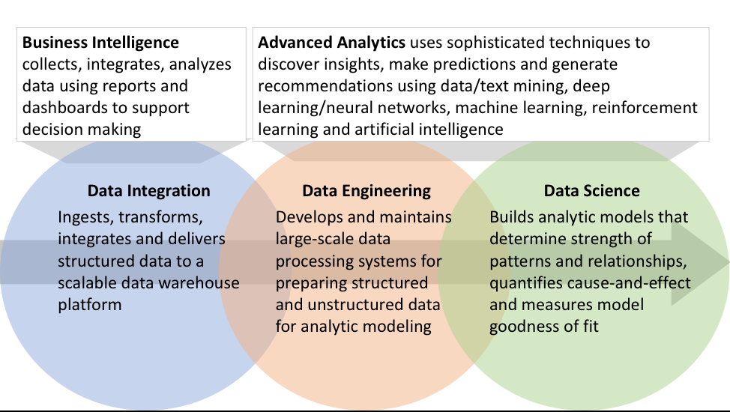
What is Data Engineering?
Data engineering is the aspect of data science that focuses on practical applications of data collection and analysis.
Data engineers focus on the applications and harvesting of big data, such as creating interfaces and mechanisms for the flow and access of information.
Notes:
As the the data space has matured, data engineering has emerged as a separate and related role that works in concert with data scientists.

Slide 3
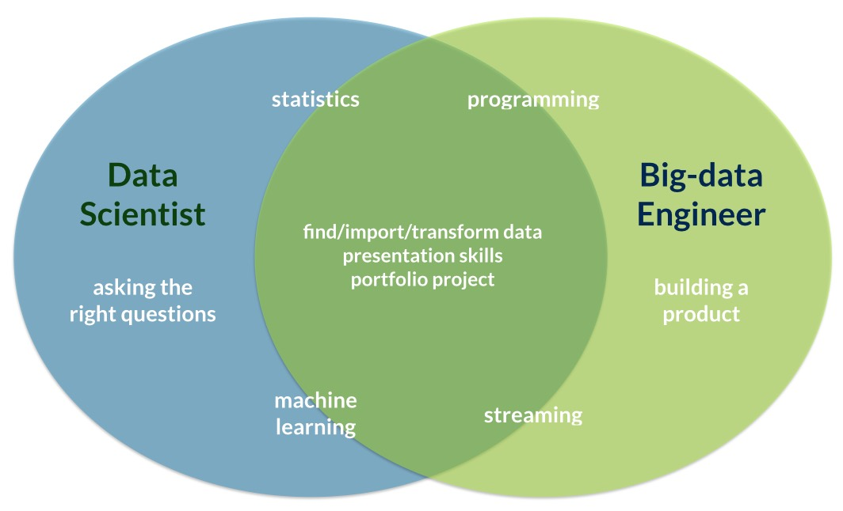
Data Engineering vs. Data Science
Notes:
Key difference is in goal - grouping/classification (text mining) vs. meaning & context (NLP)
NLP Introduction: https://blog.algorithmia.com/introduction-natural-language-processing-nlp/

Slide 4
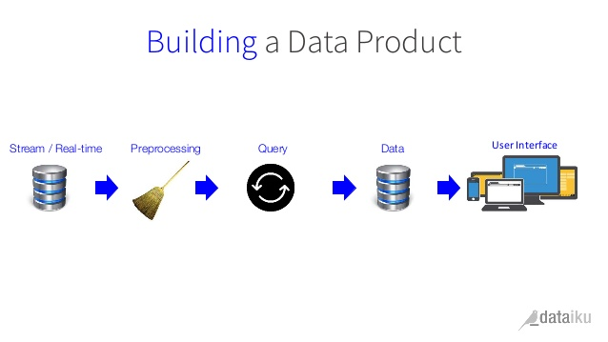
Reporting & Analytics
Reporting & Analytics is focused on the delivery of data to meet business objects, in the form of “Data Products” such as, but not limited to:
Raw data feeds
Reports
Data science packages/APIs
ML & other algorithms
Information dashboards
Mobile BI

Slide 5
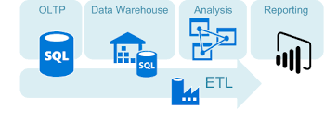
Data Architecture
A data engineer’s knowledge of data architectures includes: Data Storage, Modeling & Integration.
Databases, including RDBMS, OLTP & HDFS
Relational and non-relational database design
Information flow & real-time processing
Query execution and optimization
Comparative analysis of data stores
ETL Processes
Database setup and management
Data infrastructure design and build

Slide 6
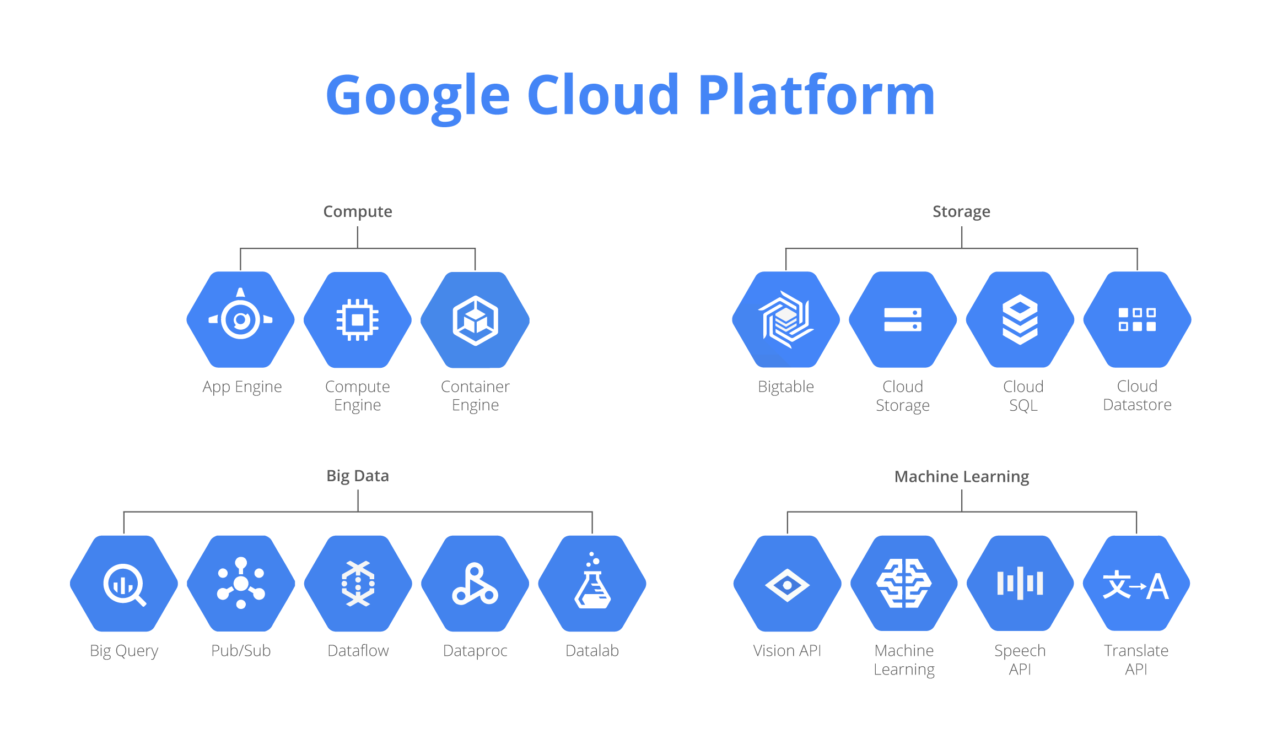
Example - Google Cloud Platform
The Google Cloud Data Engineer possess the ability to:
Build and maintain data structures and databases
Design data processing systems
Analyze data and enable machine learning
Model business processes for analysis and optimization
Design for reliability
Visualize data and advocate policy
Design for security and compliance
Notes:
Dataproc - Apache Hadoop, interactive tool created to explore, analyze, transform and visualize data and build machine learning models on Google Cloud Platform

Slide 7

Creating Workflows using Dataiku
Dataiku supports the creation of data products, and adheres to Change Management Processes, as follows:
Project Management: Manage & track large scale projects from data management
Operationalization: Automate, operationalize, and monitor data pipelines without re-thinking existing infrastructures
Reproducibility: deployed code reproducible and unmaintained projects won’t fail.
Code & Integration: Build end-to-end solutions and services with Dataiku’s transparent SDK or leading GUI.
Scalability: Leverage your existing distributed storage and processing infrastructures.
DSS comes with built-in Git-Based version control system
Dataiku DSS “Bring data analysts, engineers, and scientists together”, “Enables self-service analytics” and “operationalizes machine learning”.
AWS Instance: ec2-54-183-168-126.us-west-1.compute.amazonaws.com
ts today and build for tomorrow.
Notes:
DSS creates and handles git repository automatically - can have more control over it: Version Control - Dataiku DSS 5.0 Documentation

Slide 8
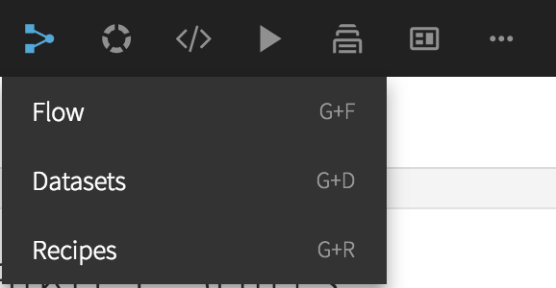
Dataiku Components
A dataset is a tabular view into your data that allows you to access, visualize and write data.
Recipes are a set of actions to perform on one or more input datasets, resulting in one or more output datasets.
Recipes include: Code (SQL, Python, E) or Visual (built-in)
A Flow (Pipeline) is a visual representation of your work as a set of dependencies between datasets and the recipes used to produce them.
Notes:
The Lab is a place for drafting your work, whether it is preliminary data exploration and cleansing or machine learning models creation. The Lab environment contains:
the Visual Analysis tool to let you draft data preparation, charts, and machine learning models
the Code Notebooks to let you explore your data interactively in the language of your choice
Note that some tasks can be performed both in the lab environment and using recipes in the flow. Here are

Slide 9
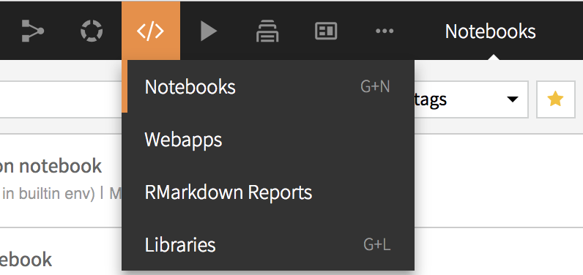
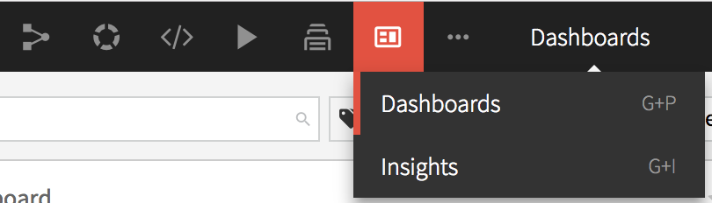
Dataiku Components
.
The code lab allows you to experiment with your data in Jupyter notebooks. You can perform interactive analysis in then deploy them to the Flow as code recipes.
The Dashboard is a communication tool to organize, share, and deliver the Insights of your data project. Insights can include any Dataiku DSS object, such as charts, datasets, web apps, and reports.
Notes:
The Lab is a place for drafting your work, whether it is preliminary data exploration and cleansing or machine learning models creation. The Lab environment contains:
the Visual Analysis tool to let you draft data preparation, charts, and machine learning models
the Code Notebooks to let you explore your data interactively in the language of your choice
Note that some tasks can be performed both in the lab environment and using recipes in the flow. Here are

Slide 10
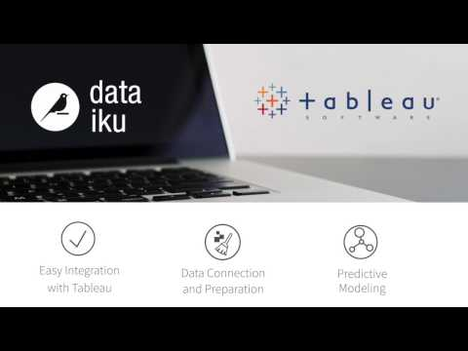
Data Product via Dataiku - Tableau
Notes:
The Lab is a place for drafting your work, whether it is preliminary data exploration and cleansing or machine learning models creation. The Lab environment contains:
the Visual Analysis tool to let you draft data preparation, charts, and machine learning models
the Code Notebooks to let you explore your data interactively in the language of your choice
Note that some tasks can be performed both in the lab environment and using recipes in the flow. Here are

Slide 11
Data Engineering via Dataiku
Steps to Engineering a Dataiku Workflow:
Create a new project
Connect to and/or Import Dataset(s)
Visual Prep - Data “Recipes”
Code Transformation(s) - Python
Visual Analysis, Data Prep & ML (The Lab)
Data Product Development
Reports, Dashboards, Insights, WebApps
Job, Workflow & Scenario Scheduling
Workflow Monitoring & Maintenance
Documentation - Wiki & Juypter Notebooks
Dataiku DSS “Bring data analysts, engineers, and scientists together”, “Enables self-service analytics” and “operationalizes machine learning” ts today and build for tomorrow.
Notes:
The Lab is a place for drafting your work, whether it is preliminary data exploration and cleansing or machine learning models creation. The Lab environment contains:
the Visual Analysis tool to let you draft data preparation, charts, and machine learning models
the Code Notebooks to let you explore your data interactively in the language of your choice
Note that some tasks can be performed both in the lab environment and using recipes in the flow. Here are

